Slide 1
Primer
Wetlands and Climate

Slide 2
Wetland Degradation and Loss
Artificial drainage of wetlands and hydric soils
Mechanical disturbance from agriculture
Altered hydrology
Inorganic fertilizers and composting
Filling/dredging
Land Development and Agricultural
Global losses of 50%: and over 90% in many countries (Dugan 1993). Varying in USA from 9% loss in New Hampshire to over 90% loss in California (Dahl 1990).

Slide 3
Changes in Wetland Areas 1800 to 2006 (x 10^3 km^2) (From Bridgham et al 2006).
 | Peatlands | Freshwater mineral | Tidal marsh | Mangrove | Mudflat | Totals
Canada--Now | 1136 | 159 | .44 | 0 | 6 | 1301
Canada-historic | 1150 | 359 | 1.3 | 0 | 7 | 1517
USA--Now | 225 | 868 | 21.4 | 3 | 9 | 1127
USA-Historic | 243 | 1308 | 23.4 | 4 | 10 | 1597
Mexico-Now | 10 | 21 | 0 | 5 | ND | 36
Mexico- Historic | 45 | 45 | 0 | 8 | ND | 53
North America--Now | 1372 | 1047 | 22 | 8 | 15 | 2463
North America--Historic | 1407 | 1706 | 25 | 12 | 17 | 3167
CHANGE | -2.5% | -39% | -12% | -33% | -12% | -22%
Global-Now | 3443 | 2315 | 22 | 181 | ND | 5961
Global-Historic | 4000 | 5000 | 29 | 278 | ND | 9307
CHANGE | -14% | -54% | -24% | -35% | -12% | -36%

Slide 4
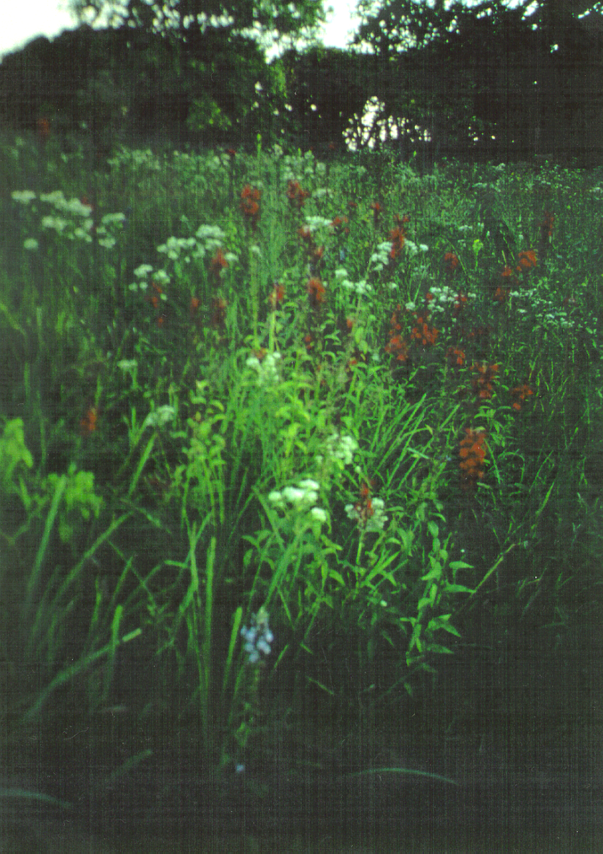
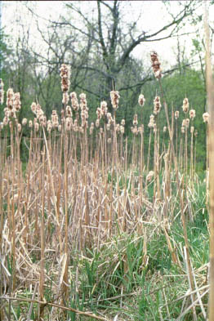
DEGRADATION OF WETLANDS

Slide 5
Wetlands and Climate Change
(C-Sequestration minus CH4-Emissions)
Wetlands are the most productive ecosystem in the world (Whittaker and Likens 1973).
Largest carbon pools of Stored C on earth (Eswaran, van Den berg, and Reich 1993).

Slide 6
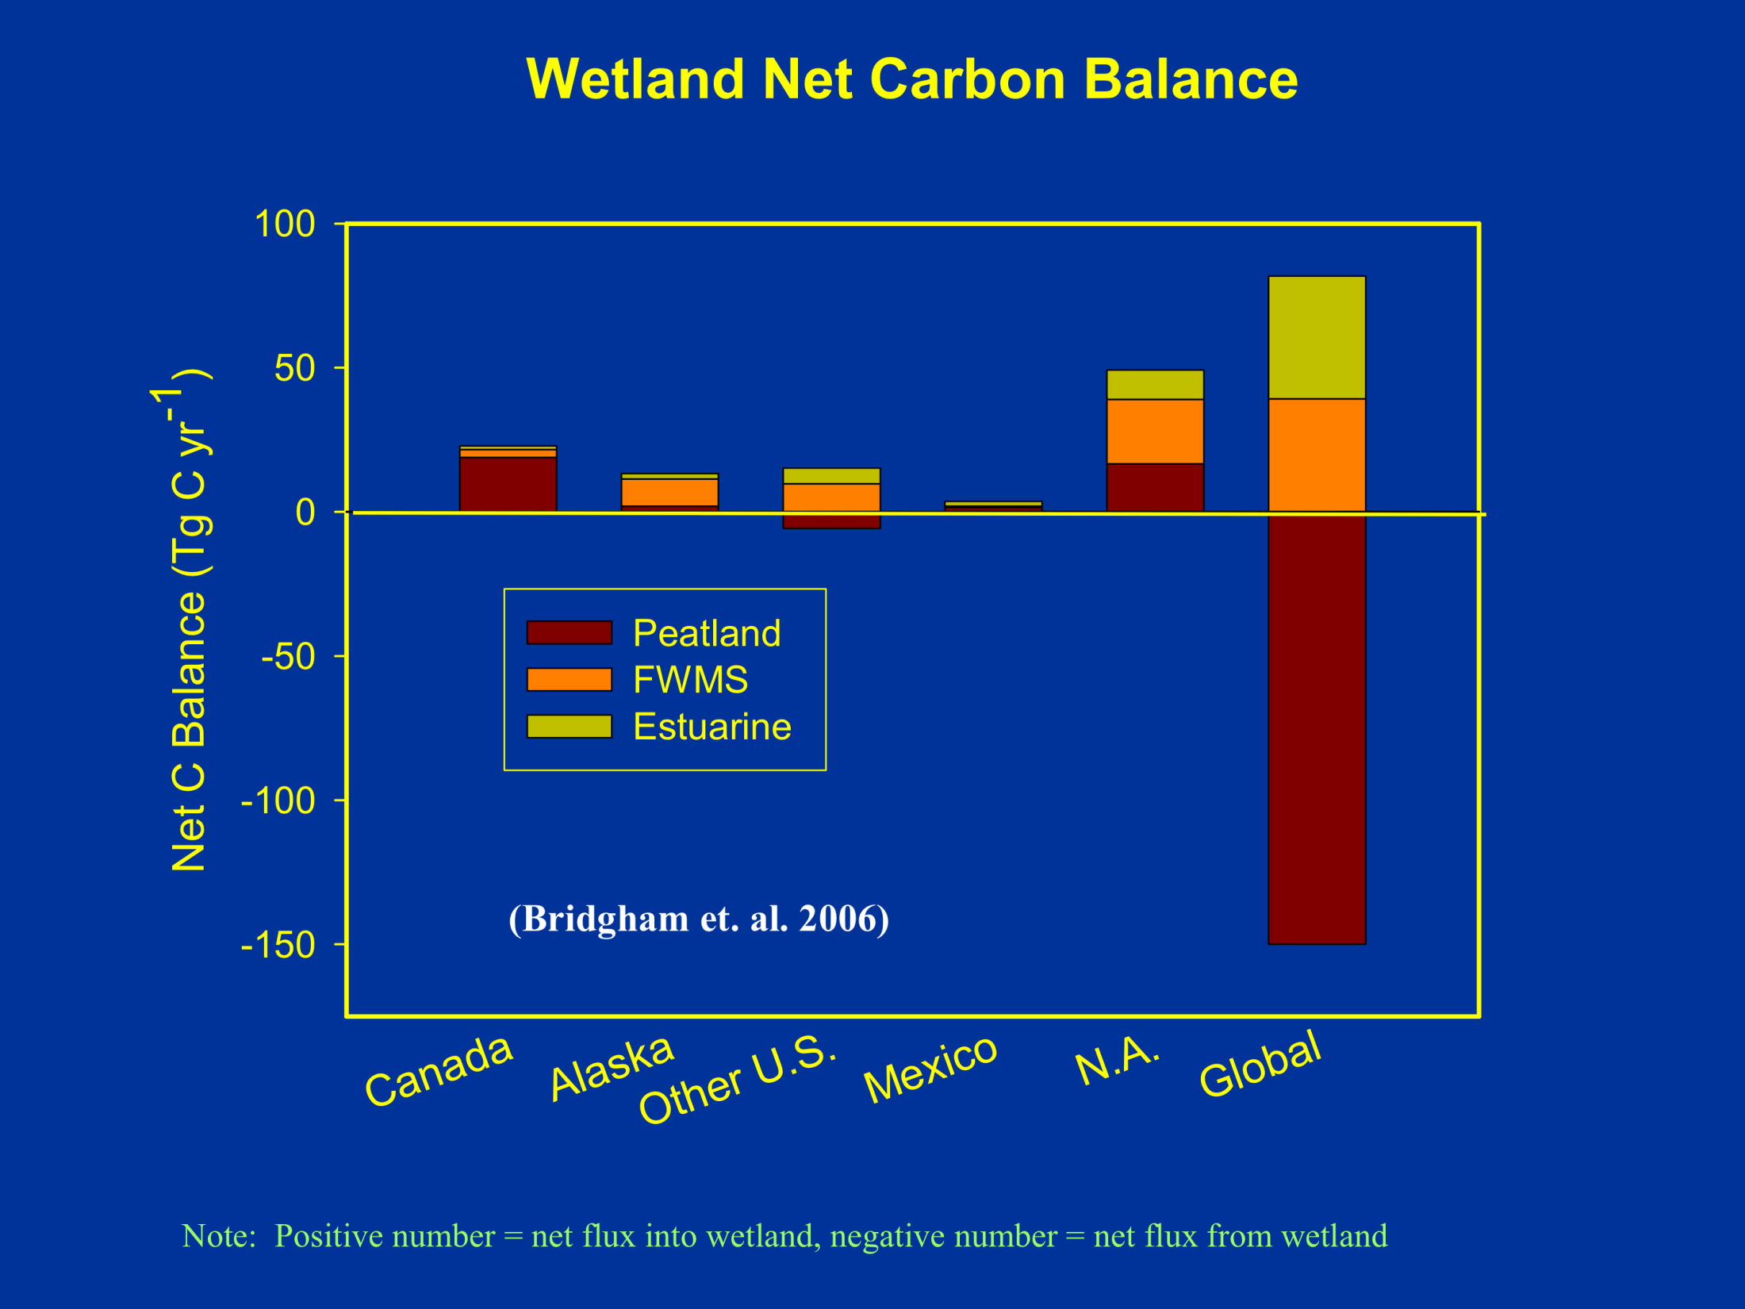
(Bridgham et. al. 2006)
Note: Positive number = net flux into wetland, negative number = net flux from wetland
Notes:
--Note change in scale.
--Peatland oxidation rates based upon analyses of Armentano and Menges and Maltby and Immirzi in the late 1980s and early 1990s.
--total for globe = -68

Slide 7
Wetland Soil Carbon Pools (Pg) and Fluxes (Tg yr-1) (From Bridgham et al 2006).
 | Peatlands | Freshwater mineral | Tidal Marsh | Mangrove | Mudflats | Totals
North America—Now
Carbon Pool Size (Pg) | 177 | 36 | .44 | .19 | .28 | 215
Sequestration (Tg yr^-1) | 29 | 17.7 | 4.8 | 2.1 | 3.3 | 57.2
Net Carbon Balance (Pg) | 17 | 22.3 | 4.8 | 2.1 | 3.3 | 49.2
Change in FLUX from Historic (Tg yr^-1) | -19.6 | -11 | -0.53 | -1.0 | -0.48 | -32.7
% CHANGE in acreage | -2.5% | -39% | -12% | -33% | -12% | -22%
Global-Now
Carbon POOL Size (Pg) | 462 | 46 | .43 | 4.9 | ND | 513
Sequestration (Tg yr^-1) | 55 | 39 | 4.6 | 38 | nd | 137
Net Carbon Balance (Pg) | -150 | 39 | 4.6 | 38 | nd | -68
Change in FLUX from Historic (Tg yr^-1) | -221 | -45 | -.69 | -20 | nd | -287
%CHANGE in acreage | -14% | -54% | -24% | -35% | -12% | -36%

Slide 8
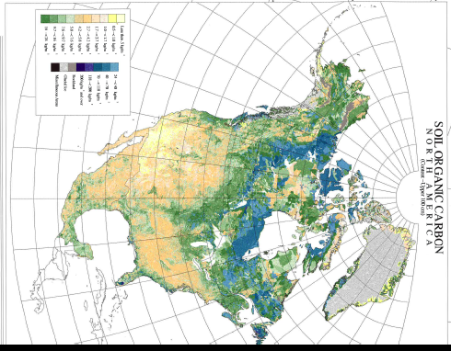
Potential for Wetland Restoration and Climate Mitigation
Estuarine
Arctic, Boreal Peatlands
Midwest Agriculture/Great Lakes
Coastal Freshwater, Brackish, Salt Water

Slide 9
Wetland Soil Carbon Pools (Pg) and Fluxes (Tg yr-1), and Annual Sequestration (TC/ ha and TCo2e-ha) (Calculated using Bridgham et al 2006).
 | Peatlands | Freshwater mineral | Tidal Marsh | Mangrove | Mudflats | Totals
North America—Now ( km^2) | 1372000 | 1047000 | 22000 | 8000 | 15000 | 2463000
Carbon Pool Size (Pg) | 177 | 36 | .44 | .19 | .28 | 215
Total Sequestration (Tg yr^-1) | 29 | 17.7 | 4.8 | 2.1 | 3.3 | 57.2
Sequestration rate in Tg/yr /km^2 | 47312 | 59152 | 4583 | 3809 | 4545 | 43059
Sequestration rate Ton of C/ha per year | 4.39 | 5.36 | .41 | .34 | .41 | 3.9
Tons oc Co2e/ha-yr | 16.06 | 19.61 | 1.5 | 1.2 | 1.5 | 14.27
Global-Now (km^2) | 3443000 | 2315000 | 22000 | 181000 | ND | 5961000
Carbon POOL Size (Pg) | 462 | 46 | .43 | 4.9 | ND | 513
Total Sequestration (Tg yr^-1) | 55 | 39 | 4.6 | 38 | ND | 137
Sequestration rate in Tg/yr /km^2 | 62,600 | 59358 | 4782 | 4763 | ND | 43510
Sequestration rate Ton of C/ha per year | 5.67 | 5.38 | .43 | .43 | ND | 3.9
Tons oc Co2e/ha-yr | 20.7 | 19.7 | 1.6 | 1.6 | ND | 14.27

Slide 10
Pocosin Wetlands, Coastal North Carolina
Must re-saturate peat substrates to reduce annual oxidation and GHG release and to prevent wildfires.

Slide 11
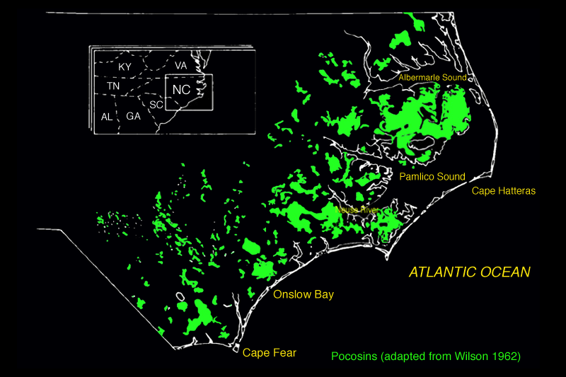
(from Richardson 1981, 1983))

Slide 12
Peatlands (Wetlands)
Peatlands occupy 3% of the global terrestrial surface yet contain 16-33% of the earths soil carbon pool (Gorham 1991).

Slide 13
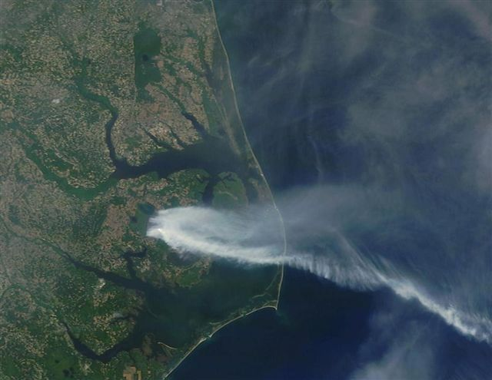
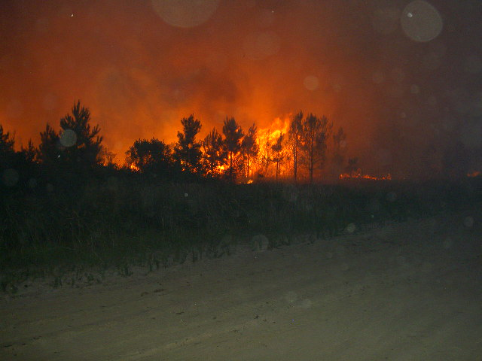
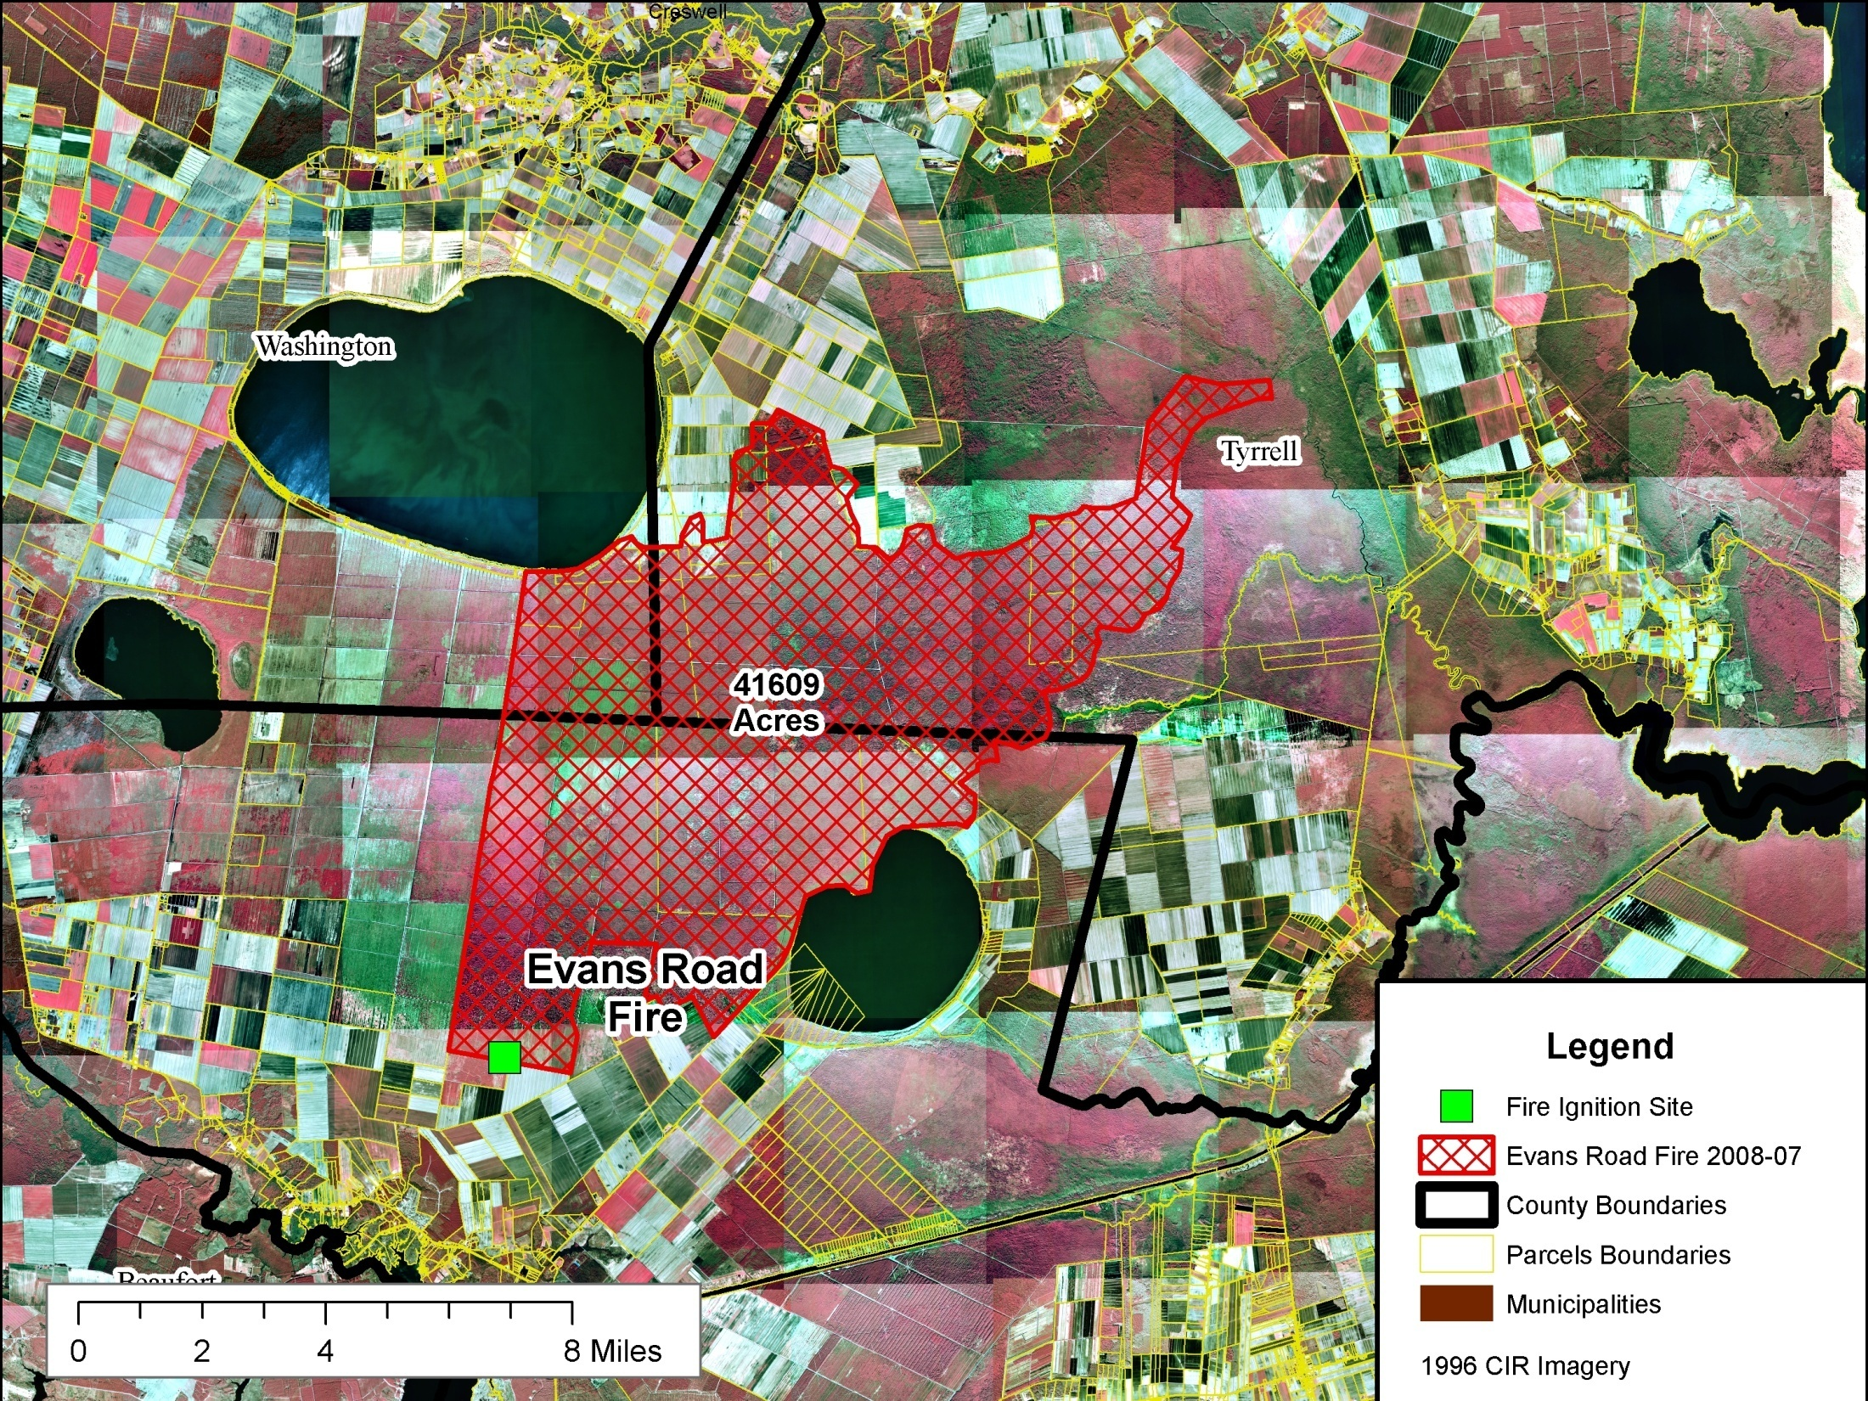
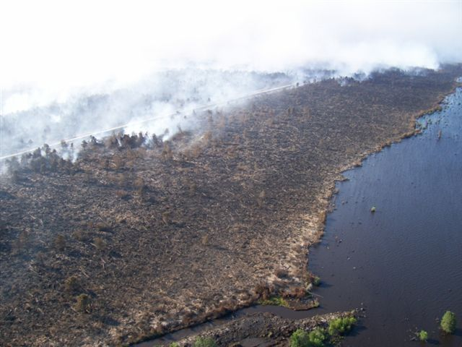
How much carbon was emitted? (Peat Fire, June –Sept 2008).
9.9 Tg C on the 16,814 burned hectares: > total USA vehicle emissions for 2008
Mickler and Welch 2012

Slide 14
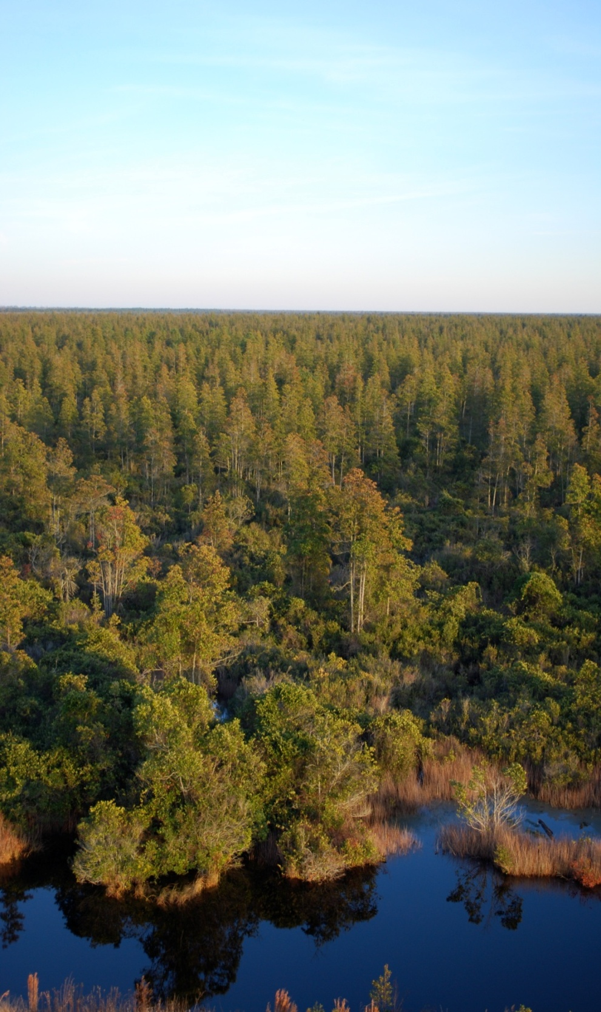
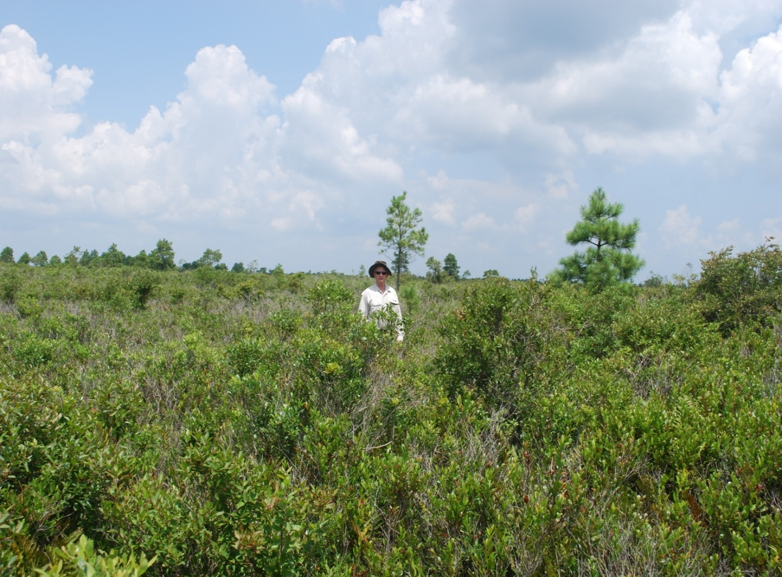
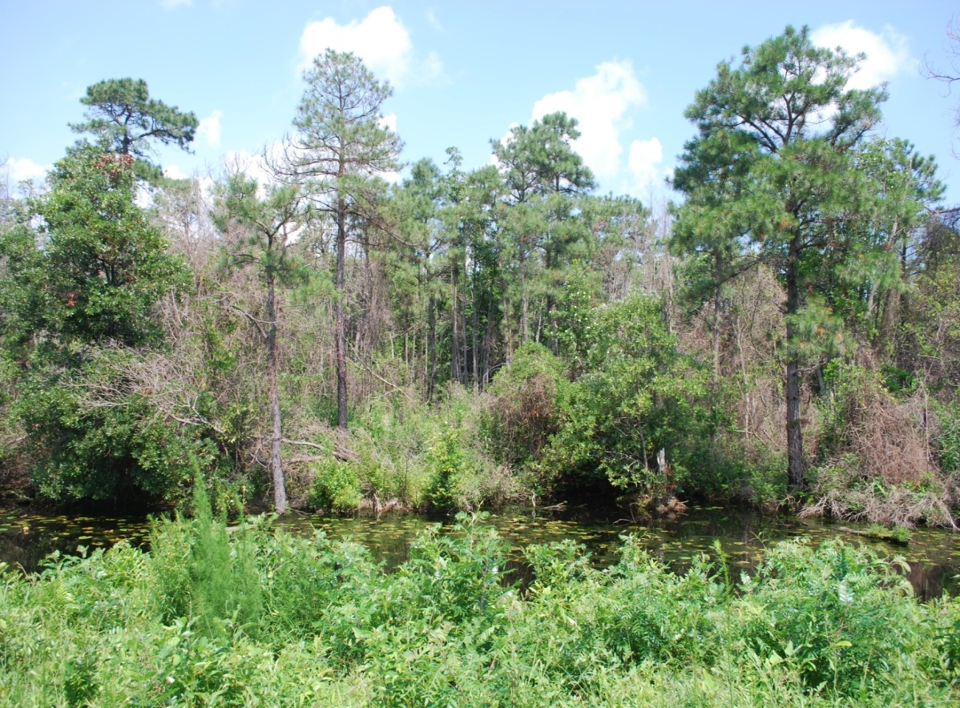
Source: Richardson Duke University
Hydrology restoration of Pocosins Wetlands, NC
Protects 6100 lbs/C/acre per year

Slide 15

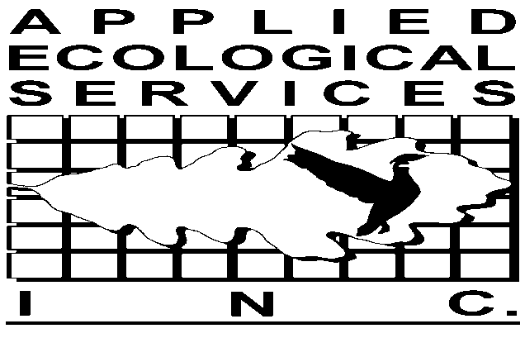
Fair Oaks Farm, Indiana
7300 acres of drained landscape, 5000 of wetland being restored
  Restoration of native plant communities, rare habitats, and rare species
Measured and predicted carbon improvements:
  Sequester 7-12 tons of C/acre-yr, or ~50,000 tons/C-yr or 183,000 TCO2equ/yr.
  Add the reduction in 2-5 tons of C02eq/acre/ yr from dewatering effects.
Indiana Chapter

Slide 16
Newton County, Indiana

Slide 17
Fair Oaks Farm
Restoration plans

Slide 18
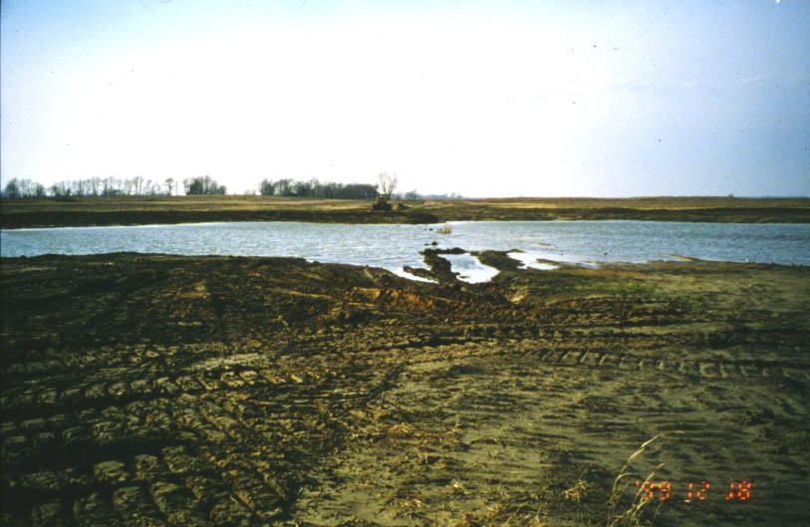
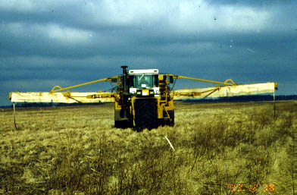
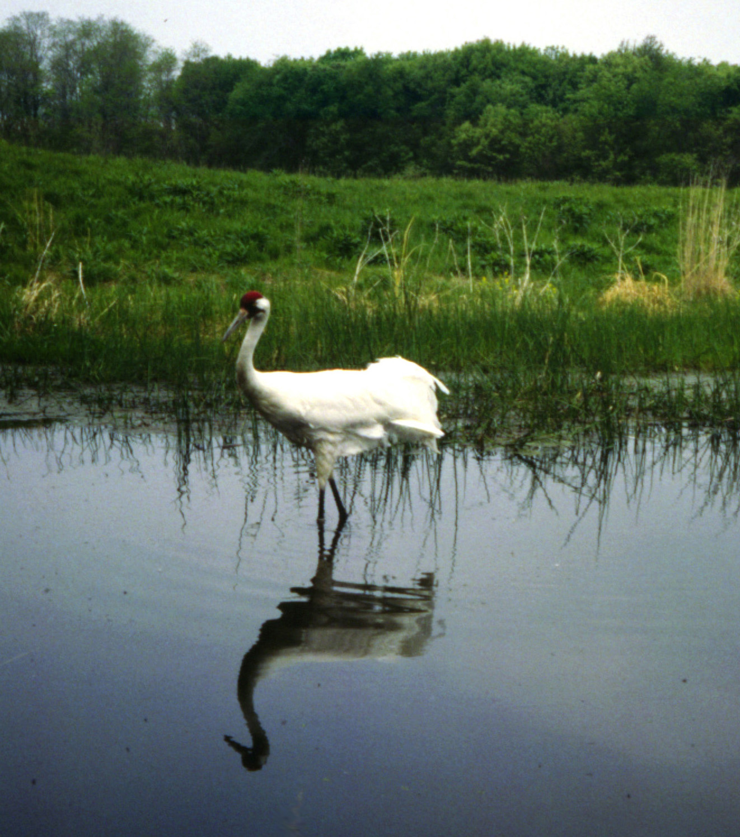
Restoration of hydrology, seeding and wildlife habitat

Slide 19
KEY POINTS
High Recovery and Climate Mitigation Benefits: Wetlands have the highest carbon sequestration rates measured in nature, and a rapid recovery once restoration begins.
    7-14 Ton C/acre-year documented.
    Disproportionately large planetary carbon sink
Wetland Degradation: Conversion losses and on-going degradation presents a huge wetland restoration and climate mitigation opportunity.
    50-90% losses from development, agricultural uses in USA/globally.
Multiple Co-Benefits: The restoration of wetlands benefits climate, water cycles, and the habitat needs of a majority of wildlife, fisheries and other life, including humans.
    Can hold 1-1.5 million gallons of water per acre.
    Provide significant downstream FDR benefits.
    Disproportionate support of T and E wildlife, and planetary biodiversity
Global Program of Restoration, Protection Needed Now!

Slide 20


Slide 21
Wetlands and Methane Emissions
Wetlands emit 15-40% (92-237 x 10^12 g CH4/yr) of the global total Methane emission.
  Some evidence that global warming since 1990’s may have resulted in increased CH4 from wetlands.
  Not certain how increased atmospheric C02 impacts wetlands: some studies suggest higher wetland productivity occurs, and Co2 update may balance with Ch4 emissions.

